Slide 1
Compiler Design for Accelerating Applications on Coarse-Grained Reconfigurable Architectures
Mahesh Balasubramanian

Slide 2
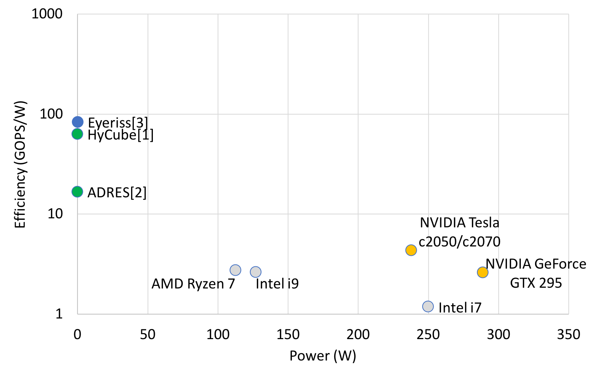
Need for Efficient Accelerators
ASIC
CGRA
CPU
GPU
[1] Karunaratne, M., Mohite, A. K., Mitra, T., & Peh, L. S. (2017, June). Hycube: A cgra with reconfigurable single-cycle multi-hop interconnect. In Proceedings of the 54th Annual Design Automation Conference 2017 (pp. 1-6).
[2] Bouwens, F., Berekovic, M., Kanstein, A., & Gaydadjiev, G. (2007, March). Architectural exploration of the ADRES coarse-grained reconfigurable array. In International Workshop on Applied Reconfigurable Computing (pp. 1-13). Springer, Berlin, Heidelberg.
[3] Chen, Y. H., Krishna, T., Emer, J. S., & Sze, V. (2016). Eyeriss: An energy-efficient reconfigurable accelerator for deep convolutional neural networks. IEEE journal of solid-state circuits, 52(1), 127-138.

Slide 3
Application/Domain Specific Accelerators
There is an increased interest in accelerating neural networks application like, Convolution Neural Network (CNN), Deep Neural Networks etc.
These accelerators have array of Processing Elements (PEs) that can perform application specific operations like multiply-and-add, and can accumulate the intermediate results across the PEs via an interconnect network.
Example, Eyeriss[1], Marvel[2], etc.
The compiler and hardware are optimized for power, performance, area, and energy for a particular application with:
Minimum interconnects
Data fed into the PEs in a particular fashion (like output stationary)
Values stored in the register.
[1] Chen, Y. H., Krishna, T., Emer, J. S., & Sze, V. (2016). Eyeriss: An energy-efficient reconfigurable accelerator for deep convolutional neural networks. IEEE journal of solid-state circuits, 52(1), 127-138.
[2] Chatarasi, Prasanth, Hyoukjun Kwon, Natesh Raina, Saurabh Malik, Vaisakh Haridas, Angshuman Parashar, Michael Pellauer, Tushar Krishna, and Vivek Sarkar. "Marvel: A data-centric compiler for dnn operators on spatial accelerators." arXiv preprint arXiv:2002.07752 (2020).

Slide 4
Compiler Design for ASICs is Selective
The compiler design for neural network accelerator is targeted for a particular type of application.
Marvel [1] formulates the constraints for the application specific accelerators as follows:
The application should be perfectly nested.
The order of the loops can be interchanged.
The loops should not contain conditional statements (branches).
The loops should not have inter-dependences. (loop carried dependencies).
A compiler and hardware design for loops is important to accelerate applications that are compute-intensive yet non-parallel, which cannot be accelerated through ASICs.
[1] Chatarasi, Prasanth, Hyoukjun Kwon, Natesh Raina, Saurabh Malik, Vaisakh Haridas, Angshuman Parashar, Michael Pellauer, Tushar Krishna, and Vivek Sarkar. "Marvel: A data-centric compiler for dnn operators on spatial accelerators." arXiv preprint arXiv:2002.07752 (2020).

Slide 5
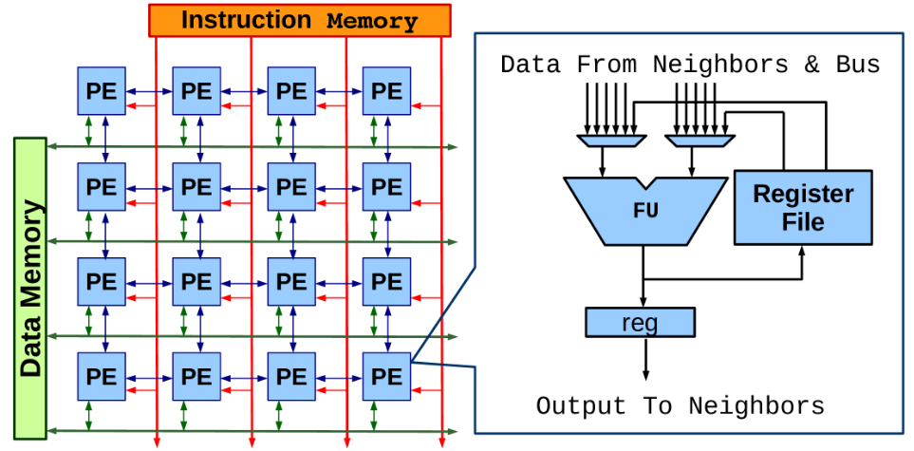
Coarse Grained Reconfigurable Array (CGRA)
An array of Processing Elements (PEs); each PE has ALU-like functional unit that works on an operation at every cycle.
Array configurations vary in terms of –
Array Size
Functional Units
Interconnect Network
Power Efficient Acceleration
Embedded Systems and Multimedia [Samsung SRP processor]

Slide 6
Envisioned Use of CGRAs
Processor
co-processor
Program thread
Kernel to accelerate
E₀
E₁
E₂
E₃
E₄
E₅
E₆
E₇
E₈
E₉
E₁₀
E₁₁
E₁₂
E₁₃
E₁₄
E₁₅
Specific kernels in an application can be power/performance critical
The kernel can be scheduled and mapped for execution on CGRA by compiler
Using the CGRA as a co-processor (accelerator)
The kernel is now executed in a power-efficient manner.

Slide 7
Accelerating loops on CGRA
Mapping
Iteration: i-1,i
Iteration: i,i+1
Time
Modulo Scheduling
a
a
g
T_{i}
c
%
time
b
c
b
g
a
g
0
a
f
e
f
e
T_{i+1}
b
c
1
b
c
II = 3
g
g
f
e
f
2
e
(a) DFG of a loop
T_{i+2}
1
2
Iterative Modulo Scheduling
Each loop iteration is executed at II cycles [Bob Rau, MICRO 1994]
T_{i+3}
a
(b) Target CGRA
Software Pipelining
Operations from 2 different iterations execute simultaneously

Slide 8
Overview
Thesis Contributions
PathSeeker: A Fast Mapping Algorithm for CGRAs
CGRA Compilation and Simulation Framework
Capabilities of the Framework
Challenges and improvements

Slide 9
Compiler Design for Accelerated Computing on CGRAs
Thesis statement: Effective compiler technology and codesign approach is crucial in achieving efficient acceleration of applications on CGRAs.
Randomized Scheduling Algorithm
Failure-Aware Mapping Algorithm
Co-design Approach for Mapping Conditionals
Compilation Simulation Framework for CGRAs

Slide 10
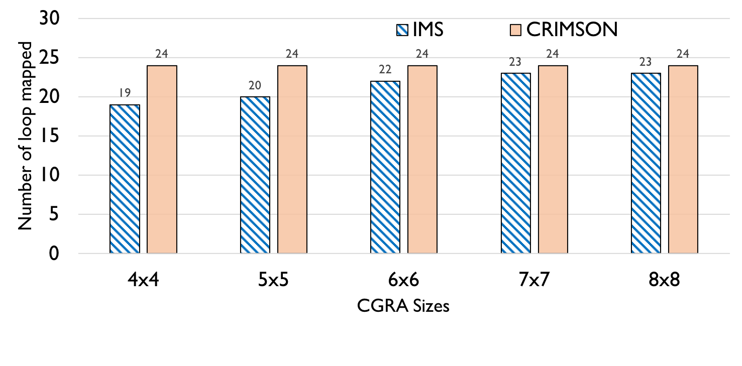
[TCAD 2020] Mahesh Balasubramanian and Aviral Shrivastava, “CRIMSON: Compute-intensive loop acceleration by Randomized Iterative Modulo Scheduling and Optimized Mapping on CGRAs.”, in IEEE Transactions on Computer-Aided Design of Integrated Circuits and Systems, 2020.

Slide 11
Compiler Design for Accelerated Computing on CGRAs
Thesis statement: Effective compiler technology and codesign approach is crucial in achieving efficient acceleration of applications on CGRAs.
Randomized Scheduling Algorithm
Failure-Aware Mapping Algorithm
Co-design Approach for Mapping Conditionals
Compilation Simulation Framework for CGRAs

Slide 13
Compiler Design for Accelerated Computing on CGRAs
Thesis statement: Effective compiler technology and codesign approach is crucial in achieving efficient acceleration of applications on CGRAs.
Randomized Scheduling Algorithm
Failure-Aware Mapping Algorithm
Co-design Approach for Mapping Conditionals
Compilation Simulation Framework for CGRAs

Slide 14
[DATE 2018] Mahesh Balasubramanian, Shail Dave, Aviral Shrivastava, Reiley Jeyapaul, "LASER: A Hardware/Software Approach to Accelerate Complicated Loops on CGRAs", in Proceedings of the 21st International Conference on Design Automation and Test in Europe, 2018

Slide 15
Compiler Design for Accelerated Computing on CGRAs
Thesis statement: Effective compiler technology and codesign approach is crucial in achieving efficient acceleration of applications on CGRAs.
Randomized Scheduling Algorithm
Failure-Aware Mapping Algorithm
Co-design Approach for Mapping Conditionals
Compilation Simulation Framework for CGRAs

Slide 16
Overview
Thesis Contributions
PathSeeker: A Fast Mapping Algorithm for CGRAs
CGRA Compilation and Simulation Framework
Capabilities of the Framework
Challenges and improvements

Slide 17
Classification of Mapping Algorithm
Scheduling and Mapping :
Scheduling – Finds a timeslot in which a node needs to be executed (Temporal)
Mapping – Finds a Processing Elements (PE) in which a node is executed (Spatial)
Mapping algorithms can be classified into two categories:
Restart : On a failure to find a mapping for a node, the current mapping is discarded and a new mapping process is started.
Simulated Annealing, RAMP.
Backtracking : On a failure to find a mapping for a node, the previously mapped nodes is recursively unmapped and remapped to a new position until a valid mapping is found.
GraphMinor.

Slide 18
Limitations of existing techniques
Restarting techniques like RAMP, explores different routing options like memory etc., but does not address the mapping failure.
Backtracking does not address the mapping failure pertaining to the failed nodes.
Backtracking is not a suitable solution:
Unmapping the previously mapped node may not be right since the root of the problem may not be the previous node.
They do not learn from the failure and take corrective actions to rectify it.

Slide 19
Motivating Example
Attempts:
0
0
0
1
Time
2
5
2
5
Mapped | Unmapped
4
4
6
6
T_{i}
3
2
1
1
1
1
4
3
3
T_{i+1}
r
r
(a) DFG of a loop
5
0
1
2
3
4
T_{i+2}
R
R
6
(b) Target CGRA

Slide 20
Motivating Example
0
1
0
Attempts:
1
Time
2
5
2
Mapped | Unmapped
4
6
T_{i}
1
0
3
2
1
1
1
4
3
T_{i+1}
3
r
5
r
(a) DFG of a loop
5
0
1
2
3
4
T_{i+2}
4
R
6
R
6
(b) Target CGRA

Slide 21
Motivating Example
1
Attempts:
2
0
0
1
Time
2
5
2
5
Mapped | Unmapped
4
1
0
4
6
6
T_{i}
3
2
1
1
1
6
1
4
3
T_{i+1}
3
r
5
r
(a) DFG of a loop
5
0
1
2
3
4
T_{i+2}
4
R
R
R
(b) Target CGRA

Slide 22
Motivating Example
3
Attempts:
2
0
0
1
Time
2
5
2
5
Mapped | Unmapped
4
1
0
4
6
6
T_{i}
3
2
1
1
1
6
1
4
3
T_{i+1}
3
r
5
r
(a) DFG of a loop
5
0
1
2
3
4
T_{i+2}
4
R
R
(b) Target CGRA

Slide 23
Motivating Example
Attempts:
3
0
0
1
Time
2
5
2
5
Mapped | Unmapped
4
1
0
4
6
6
T_{i}
3
2
1
1
1
6
1
4
3
T_{i+1}
3
r
5
r
(a) DFG of a loop
5
0
1
2
3
4
T_{i+2}
4
R
(b) Target CGRA

Slide 24
Motivating Example
3
4
0
Attempts:
0
1
Time
2
5
2
5
Mapped | Unmapped
4
1
0
0
4
6
6
T_{i}
3
2
1
1
1
6
1
4
R
3
T_{i+1}
3
r
5
r
(a) DFG of a loop
5
0
1
2
3
4
T_{i+2}
4
(b) Target CGRA

Slide 25
Motivating Example
5
Attempts:
4
0
0
1
Time
2
5
2
5
Mapped | Unmapped
4
1
0
4
6
6
T_{i}
3
2
1
1
1
6
1
4
R
3
T_{i+1}
3
r
5
r
(a) DFG of a loop
5
0
1
2
3
4
T_{i+2}
4
(b) Target CGRA

Slide 26
Motivating Example
Fast Forward (24 attempts)

Slide 27
Motivating Example
Attempts:
29
0
0
1
Time
2
5
2
5
Mapped | Unmapped
4
1
4
6
6
T_{i}
3
2
1
1
1
6
1
R
3
T_{i+1}
3
0
(a) DFG of a loop
5
r
1
2
3
4
T_{i+2}
4
(b) Target CGRA

Slide 28
Motivating Example
30
Attempts:
29
0
0
1
Time
2
5
2
5
Mapped | Unmapped
4
1
4
6
6
T_{i}
3
2
1
1
1
6
1
4
R
3
T_{i+1}
3
r
0
(a) DFG of a loop
5
5
0
r
1
2
3
4
T_{i+2}
R
4
6
2
(b) Target CGRA

Slide 29
PathSeeker
Key Contributions:
Identify the problem node and analyze the predecessor and successor. Create data structures for each node to hold the current position and possible positions based on predecessor and successor.
Level One Recovery: Make changes to predecessor or successor nodes connected to the failed node.
Level Two Recovery : Novel Timeslot level remapping of nodes in the failed node’s timeslot. Update the predecessors and successors if there are any modifications.
Level Three Recovery: Timeslot level remapping of the nodes in the predecessor and successor’s timeslot.
Randomized placement if there are more than one possible positions.

Slide 30
PathSeeker in action
Attempts:
0
0
0
1
Time
2
5
2
5
Mapped | Unmapped
4
4
6
6
T_{i}
3
2
1
1
1
1
4
3
3
T_{i+1}
r
r
(a) DFG of a loop
5
0
1
2
3
4
T_{i+2}
R
R
6
(b) Target CGRA

Slide 31
PathSeeker in action
0
1
0
Attempts:
1
Time
2
5
2
Mapped | Unmapped
4
6
T_{i}
1
0
3
2
1
1
1
4
3
T_{i+1}
3
r
5
r
(a) DFG of a loop
5
0
1
2
3
4
T_{i+2}
4
R
6
R
6
(b) Target CGRA

Slide 32
PathSeeker in action
1
2
0
Attempts:
1
Time
2
5
2
Mapped | Unmapped
4
6
T_{i}
1
0
3
2
1
1
1
4
3
T_{i+1}
3
r
5
r
(a) DFG of a loop
5
0
1
2
3
4
T_{i+2}
4
R
6
R
6
(b) Target CGRA

Slide 33
PathSeeker in action
2
0
Attempts:
1
Time
2
5
2
Mapped | Unmapped
4
6
T_{i}
1
0
3
2
1
1
1
3
4
r
3
T_{i+1}
r
5
(a) DFG of a loop
5
0
1
2
3
4
T_{i+2}
4
R
6
R
6
(b) Target CGRA

Slide 34
PathSeeker in action
3
2
0
Attempts:
1
Time
2
5
2
Mapped | Unmapped
4
6
T_{i}
1
0
3
2
1
1
1
4
3
T_{i+1}
3
r
5
r
(a) DFG of a loop
5
0
1
2
3
4
T_{i+2}
4
R
6
R
6
(b) Target CGRA

Slide 35
PathSeeker in action
Attempts:
3
0
1
Time
2
5
2
Mapped | Unmapped
4
6
T_{i}
1
0
3
2
1
1
4
1
4
R
3
T_{i+1}
3
r
5
r
6
(a) DFG of a loop
5
0
1
2
3
4
T_{i+2}
R
6
(b) Target CGRA

Slide 36
PathSeeker in action
3
4
0
Attempts:
1
Time
2
5
2
Mapped | Unmapped
4
6
T_{i}
1
0
3
2
1
1
1
4
3
T_{i+1}
3
r
5
r
(a) DFG of a loop
5
0
1
2
3
4
T_{i+2}
4
R
6
R
6
2
(b) Target CGRA

Slide 37
Experimental Setup
Setup
35 performance-critical loops from MiBench, Rodinia, and Parboil
Innermost loop was chosen in nested loop cases
Vectorizable loops and Memory bound loops were not considered.
Compilation
LLVM 4.0
Partial Predication for if-then-else and nested if-then-else.
Path-sharing to reduce the routing nodes.
Backtracking – GraphMinor, Restart – Simulated Annealing and RAMP.
4x4, 5x5, 6x6, 7x7, 8x8 CGRA sizes.
Threshold time of 100,000 seconds (27 hours).

Slide 38
PathSeeker maps all the loops on a 4x4 CGRA

Slide 39
PathSeeker maps all the loops on a 4x4 CGRA
GraphMinor : No mapping for 20 loops
RAMP: No Mapping for 5 loops

Slide 40
PathSeeker mapped all the loops on all CGRA sizes

Slide 41
PathSeeker finds a valid mapping fast for various CGRA sizes

Slide 42
The Quality of mapping achieved is comparable to SoA
Closer to 1 is better

Slide 43
Overview
Thesis Contributions
PathSeeker: A Fast Mapping Algorithm for CGRAs
CGRA Compilation and Simulation Framework
Capabilities of the Framework
Challenges and improvements

Slide 44
Compilation Simulation Framework -- CCF
Loop Extraction
LLVM frontend passes to extract the loop
DFG generation
Frontend pass to extract loop from IR
Support for nested loops
Mapping on Target CGRA
Loop Annotation
Pragma CGRA on the loop of C file
Include Target CGRA CSV and the execution script
Generate IR for the CGRA
Schedules and Maps on the CGRA
Includes support for IMS CRIMSON -- Also support for multiple mapping algos.
Generate Machine Instructions
From the mapping and DFG generate machine instructions.
Support for multiple DFG structures, single precision floating point support.
Architectural Simulation
gem5 based CGRA simulation. Support for multiple CGRA dimensions.
Support for Single Precision FP Executions.
App
LLVM
C++
C++
gem5

Slide 45
Capabilities of CCF
Easy to execute commands and correct execution flow.
Execute benchmarks with floating point operations.
Support provided for floating point instructions and floating point immediate values.
Correct execution support of inlined functions.
Parameterized CGRA inputs and easy to add parameters
Size of CGRA, Mapping algorithm to be used are parameterized and easy to modify.
Support for multiple mapping algorithms.
Backend gem5 support for floating point execution.
User friendly gem5 backend to add multiple CGRA configurations.

Slide 46
Challenges in development
LLVM
For supporting floating point execution, the ISA bits had to be increased from 32 to 35 to include the datatype information.
Deleting the loop from the main execution flow and introducing the prolog, kernel, and epilog instructions on CGRA.
Context switch between CPU and CGRA and the prolog, kernel, epilog executions are handled by internal functions.
The hooks of the functions are added in the LLVM stage when a loop is converted to a DFG.
Inlined functions posed a challenge in accelerating the correct loop.

Slide 47
Challenges in development
Gem5
Support for more CGRA sizes. Additional sizes can be added by the user.
readMem and writeMem updated to the new AtomicCGRA.
Floating point immediate support
Floating points immediates cannot be transferred via the immediate bits of an instruction.
IEEE-754 single precision format is used to convert the number into sign, exponent, and mantissa (32 bits). Three instructions are generated (LDi, LDMi, LDUi) to transfer these 32 bits and store in the floating point registers.
Floating point execution support in each PE with dedicated floating point registers.

Slide 48
Challenges in development
Overall framework challenges
Datatype incompatibility between GCC, arm-cross-compiler, and gem5.
GCC and gem5 has unsigned long size to be 8 bytes, but arm-cross-compiler unsigned long size is 4-bytes. This prevented prolog, kernel, and epilog instructions to be truncated.
Fixed it by using unsigned long long.
Multiple inlined function, which has the pragma loop.
When multiple loops are inlined in the program, there was no information on which loop (prolog, kernel, epilog) to execute in gem5.
We added support to correctly insert executing loop numbers in LLVM and pass that information through a file in gem5.
CCF was able to compile only 9 benchmark loops before all of these support.

Slide 49
CCF Support

Slide 50



Demo time

Slide 51
Summary
I have addressed the problems with current backtracking and restarting mapping algorithms.
The main contributions of this PathSeeker are:
Failure node level analysis and changing the course of mapping path, thereby by seeking the valid mapping.
Novel failure, predecessor, and successor timeslot level remapping. As far as we know this is the first approach to propose a timeslot level remapping for CGRA.
Randomized node placement for better exploration of the mapping.
The improved CCF framework now supports multiple mapping algorithms and floating point instructions.
It can now compile 68 benchmarks loops from MiBench, Rodinia, and Parboil.

Slide 52
Future Work
CCF can be used to explore various aspects of CGRA simulation.
LLVM:
Integration with LLVM based tools like AccelSeeker to find the potential candidates and select those loops without the user needing to add pragmas.
Exploration in the direction of heterogenous accelerator paradigm.
Gem5:
CCF can be used to explore multi-core CPU, CGRA computing environment.
Explore of various CGRA location in the memory stack is also one the directions, where CGRA should be present closer to CPU or closer to L1, L2 cache or near memory.
CGRA ISA can be upgraded from 35-bits to 64-bits to include more functionality.

Slide 53
List of Publications and Patents
Journals and Conferences
[DATE 2022 under Review] Mahesh Balasubramanian, Aviral Shrivastava, “PathSeeker: A Fast Mapping Algorithm for CGRAs”.
[TCAD 2020] Mahesh Balasubramanian, Aviral Shrivastava, “CRIMSON: Compute-intensive loop acceleration by Randomized Iterative Modulo Scheduling and Optimized Mapping on CGRAs.”, in IEEE Transactions on Computer-Aided Design of Integrated Circuits and Systems, 2020.
[IPDPS 2020] Mahesh Balasubramanian, Trevor Ruiz, Brandon Cook, Mr Prabhat, Sharmodeep Bhattacharyya, Aviral Shrivastava, Kristofer Bouchard, "Scaling of Union of Intersections for Inference of Granger Causal Networks from Observational Data", in Proceedings of the 34th IEEE International Parallel and Distributed Processing Symposium, 2020.
[L4DC 2020] Trevor Ruiz, Sharmodeep Bhattacharyya, Mahesh Balasubramanian, Kristofer Bouchard, "Sparse and Low-bias Estimation of High Dimensional Vector Autoregressive Models", in Learning for Dynamics and Control, 2020.
[DAC 2018] Shail Dave, Mahesh Balasubramanian, Aviral Shrivastava, "RAMP: Resource-Aware Mapping for CGRAs", in Proceedings of the 55th Annual Design Automation Conference, 2018
[DATE 2018] Mahesh Balasubramanian, Shail Dave, Aviral Shrivastava, Reiley Jeyapaul, "LASER: A Hardware/Software Approach to Accelerate Complicated Loops on CGRAs", in Proceedings of the 21st International Conference on Design Automation and Test in Europe, 2018
[DATE 2018] Shail Dave, Mahesh Balasubramanian, Aviral Shrivastava, "URECA: A Compiler Solution to Manage Unified Register File for CGRAs", in Proceedings of the 21st International Conference on Design Automation and Test in Europe, 2018
Pending Patents
[US Patent] Mahesh Balasubramanian and Aviral Shrivastava, “System and Methods for Improved Mapping of Computational Loops on Reconfigurable Architectures. ”
[US Patent] Mahesh Balasubramanian, Shail Dave, Aviral Shrivastava, and Reiley Jeyapaul, "A Hybrid and Efficient Approach to Accelerate Complicated Loops on Coarse-Grained Reconfigurable Arrays (CGRA) Accelerator"

